Slide 1
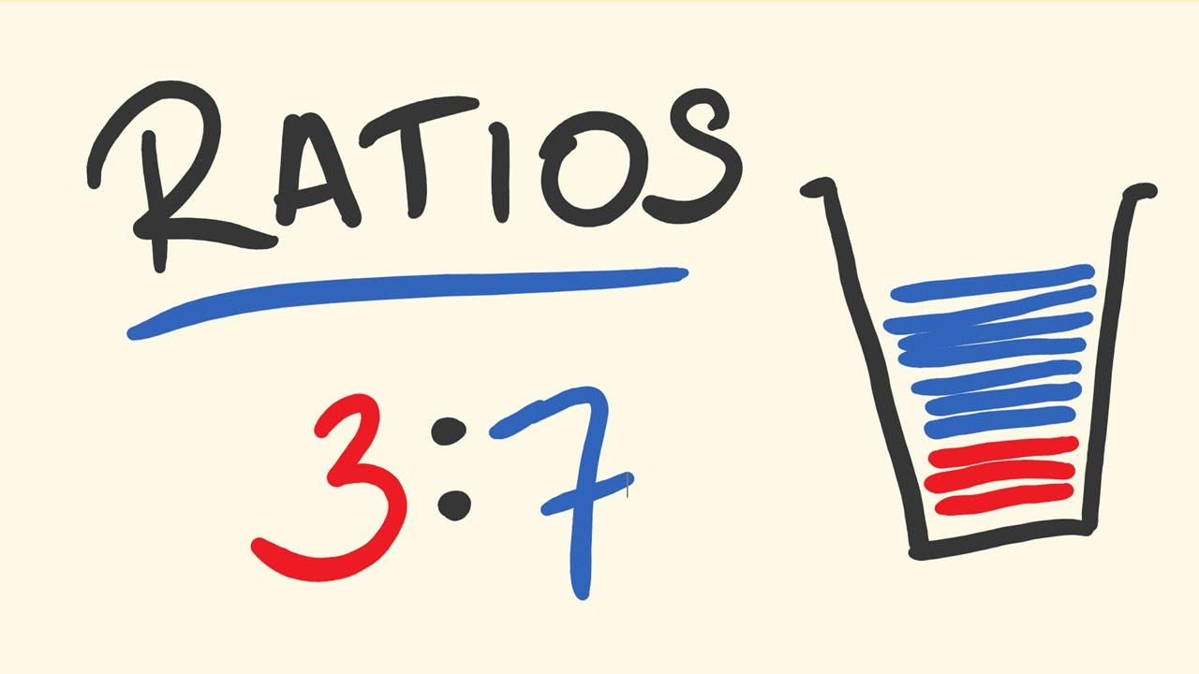
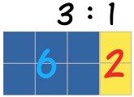
Topic: Proportion and Ratios
EQ: EQ – What is a ratio and how is it used?

Slide 2
Ratios Song
https://www.youtube.com/watch?v=-hcRMJcgpb4

Slide 3
Warm Up
Find the Highest Common Factor of the following:
6 and 18
12 and 16
6 and 27
9 and 30
27 and 81
a. 6, b. 4, c. 3, d. 3, e. 9

Slide 4
24
7
30
Date
Ratio
EQ – What is a ratio and how is it used?
What is a ratio?
Ratios are used to compare quantities with the same units.
The ratio of 2 to 5 is written as 2 : 5
If you are making orange cordial and you mix one part cordial to four parts water, then the ratio of cordial to water will be 1:4 (1 to 4).
If you use 1 litre of cordial, you will use 4 litres of water (1:4).
If you use 2 litres of cordial, you will use 8 litres of water (2:8).
If you use 10 litres of cordial, you will use 40 litres of water (10:40).
How is a ratio used?
Notice that if you had a Jug, and mixed in 1L of cordial and 4L of water, it would be 5 litres in total – this is the total parts of the ratio.

Slide 5
Date
24
7
30
Ratio
EQ – What is a ratio and how is it used?
These ratios are all equivalent
1:4 = 2:8 = 10:40
Both sides of the ratio can be multiplied or divided by the same number to give an equivalent ratio.
To simplify a ratio, you divide both sides of the ratio by the greatest common factor. Note: Make sure both sides of the ratio are using the same units of measurement.
Example:
200g : 1kg Change both sides to the same units
200g : 1000g Divide both sides by 200
1 : 5
How is a ratio used?

Slide 6



Let’s try some together.
17:4
4:17
17:21
4:21
1- Add all parts of the ratio together. This is the denominator
2- the parts of the ratio are the numerators.
3- Write as fractions
4- divide numerator by denominator for the decimal and percentage.
1/3$:2/3$
2/7 : 5/7
3/13 : 10/13
5/10 : 5/10
0.33 : 0.66
0.286 : 0.714
0.231 : 0.769
0.5 : 0.5
33.3% : 66.6%
28.6% : 71.4%
23.1% : 76.9%
50% : 50%

Slide 7
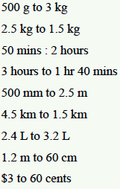

Practise with a partner
Work together to solve these ratio problems – remember to keep the order the same
500 : 3000 -> 1 : 6
2.5 : 1.5 -> 0.5 : 0.3
50 : 120 -> 5 : 12
180 : 140 -> 9 : 7
500 : 2500 -> 1 : 5
4.5 : 1.5 -> 3 : 1
2.4 : 3.2 -> 3 : 4
120 : 60 -> 2 : 1
300 : 60 -> 5 :1
1 : 2
1 : 4
0.4 : 0.3
1.0 : 0.3
3x : 5x

Slide 8
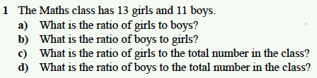

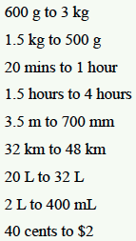

Complete the following on your own (use your notes if needed):
2.
3.
4.

